Slide 1

It has been a long week...

Slide 2

I want to find something to do on the weekend to reward myself

Slide 3
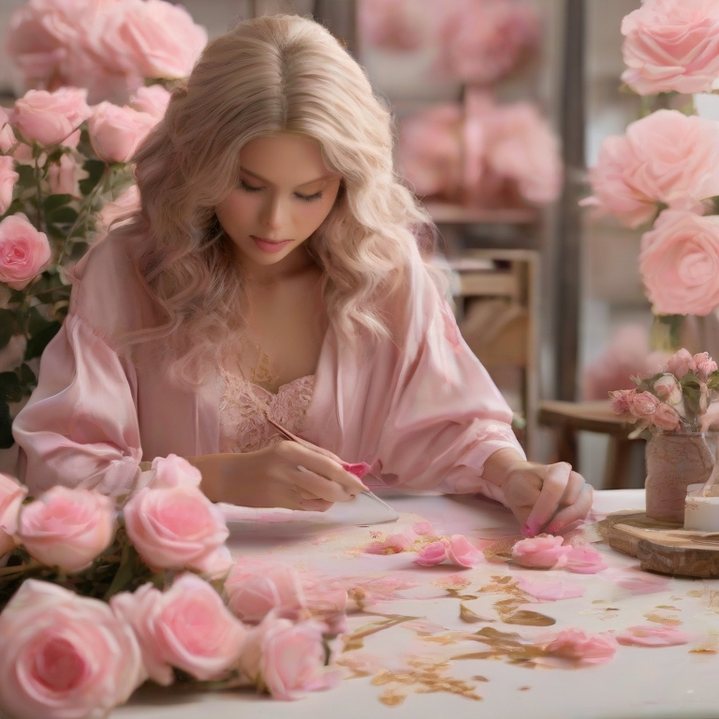
I am
Age: 25~40
Gender: female
Marital status: In relationship / Single
Interests: jewelry and hang out with friends or partner
Income: 80k ~ 100k
price non sensitive
Source: Interview

Slide 4
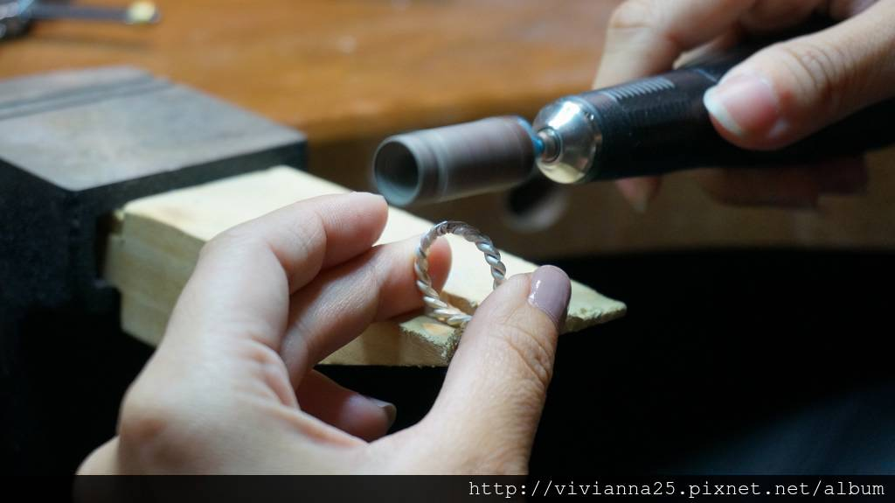
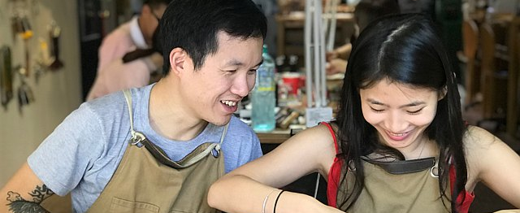
Who Value
Create precious memories with friend and loved one
Joy and achievement bring an idea to life
Taking a break from the complexities of daily life
Source: Interview
這張相片 (作者: 未知的作者) 已透過 CC BY-NC-ND 授權。

Slide 5
How many people like me:
340,766,000 people in the United States
169,030,000 US population are female
44,6385,760 US female population between 18-44
14,879,758 US population between 18-44 make 50K > a year
1,228,434 US Population 18-44 who make 50K in New York and New Jersy
If we can convert 1 in 1,000 of this population
1,228 key potential customers in New York and New Jersy
Each of them might bring 1.5~ 2 customer
1842~2456 potential customers in New York and New Jersy
For the first year
Source: https://en.wikipedia.org/wiki/Demographics_of_the_United_States
https://www.visualcapitalist.com/american-income-levels-by-age-group/
https://www.states101.com/gender-ratios/
Notes:
https://en.wikipedia.org/wiki/Demographics_of_the_United_States
https://www.visualcapitalist.com/american-income-levels-by-age-group/

Slide 6

Where are we :
Geography
Top 5 Impressions
California
Texas
Florida
New York
Geofia
Top 5 Clicks
Geogia
North carolina
New York
Alabama
Florida
Source: google Ads

Slide 7
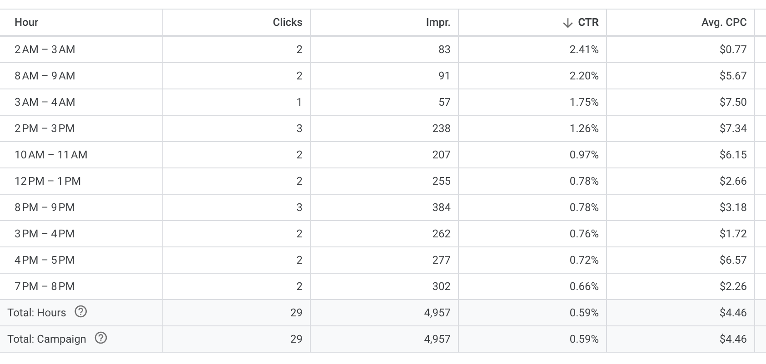
When
Most active time
7PM~ 9PM
3PM~4PM
12PM~1PM
Source: google Ads

Slide 8
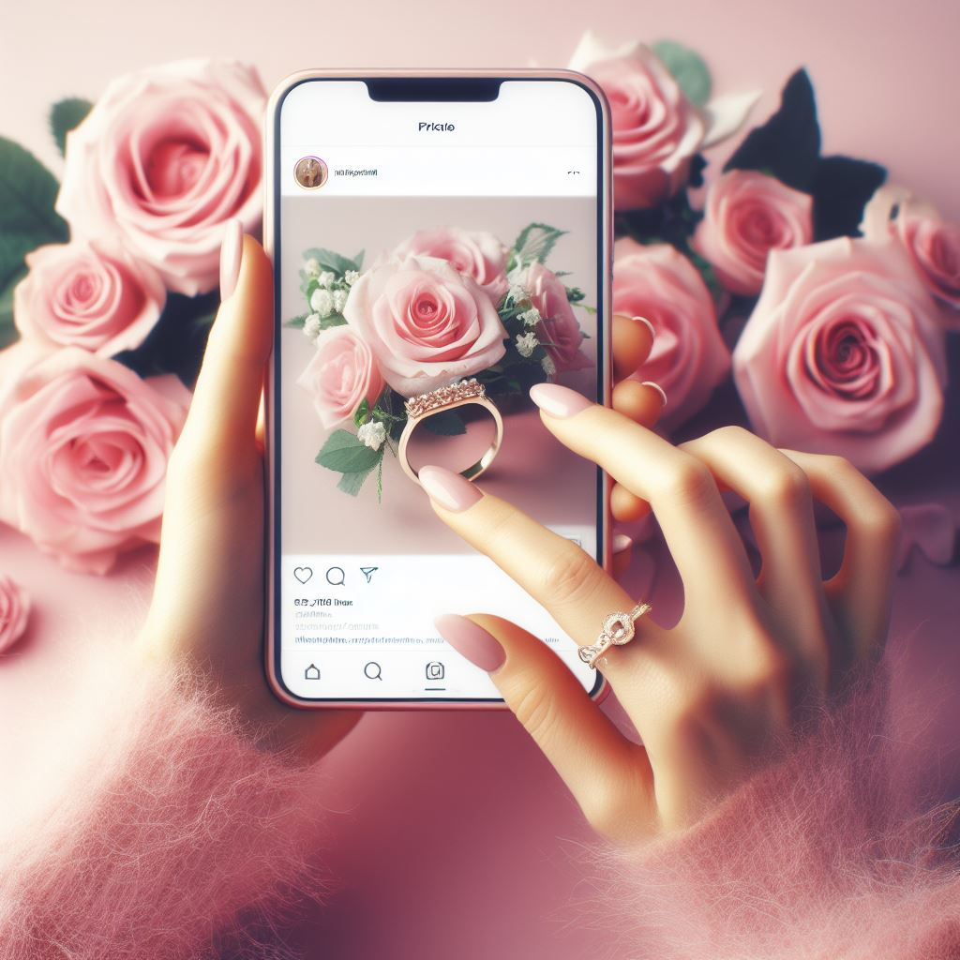
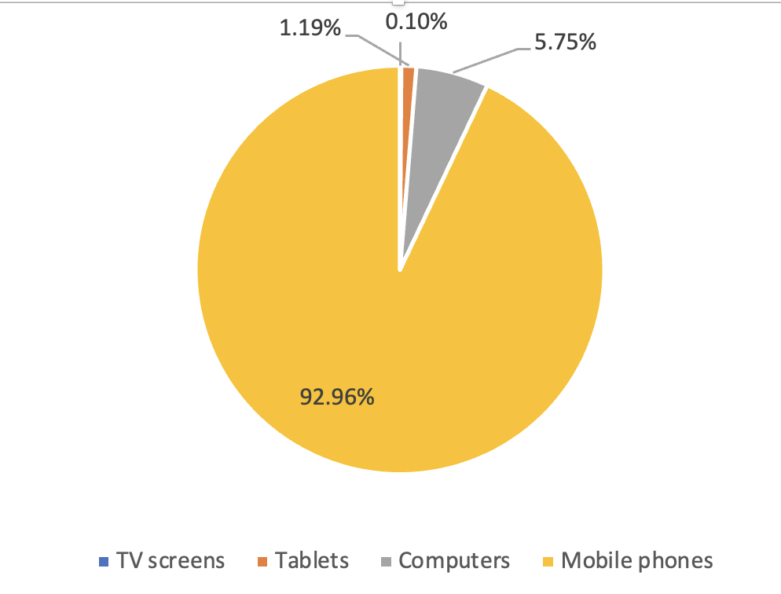
Device
All Clicks are from Cell phones.
92.96% of the Ads are view on Cell phones.
Source: google Ads

Slide 9
Most of us learn DIY Ring workshop store from
Friends
Search DIY ring from search engine
Facebook, google store review
Mobile Ads
Source: Interview

Slide 10
How to reach me
Digital: Mobile Ads (Google Ads, Meta Ads, )
Buy key words on search engine
Create owned Media: Own website, Facebook page, google store etc
Friends share a pleasant experience

Slide 11

Now you have my attention....
Time to introduce the company

Slide 12

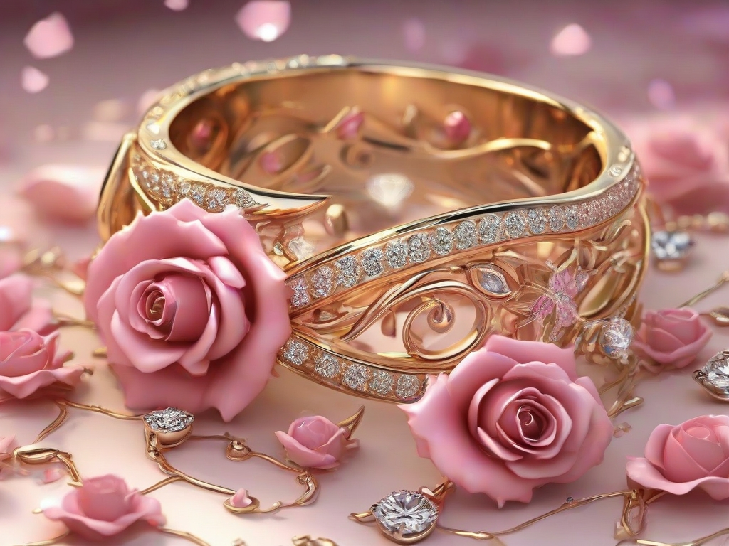
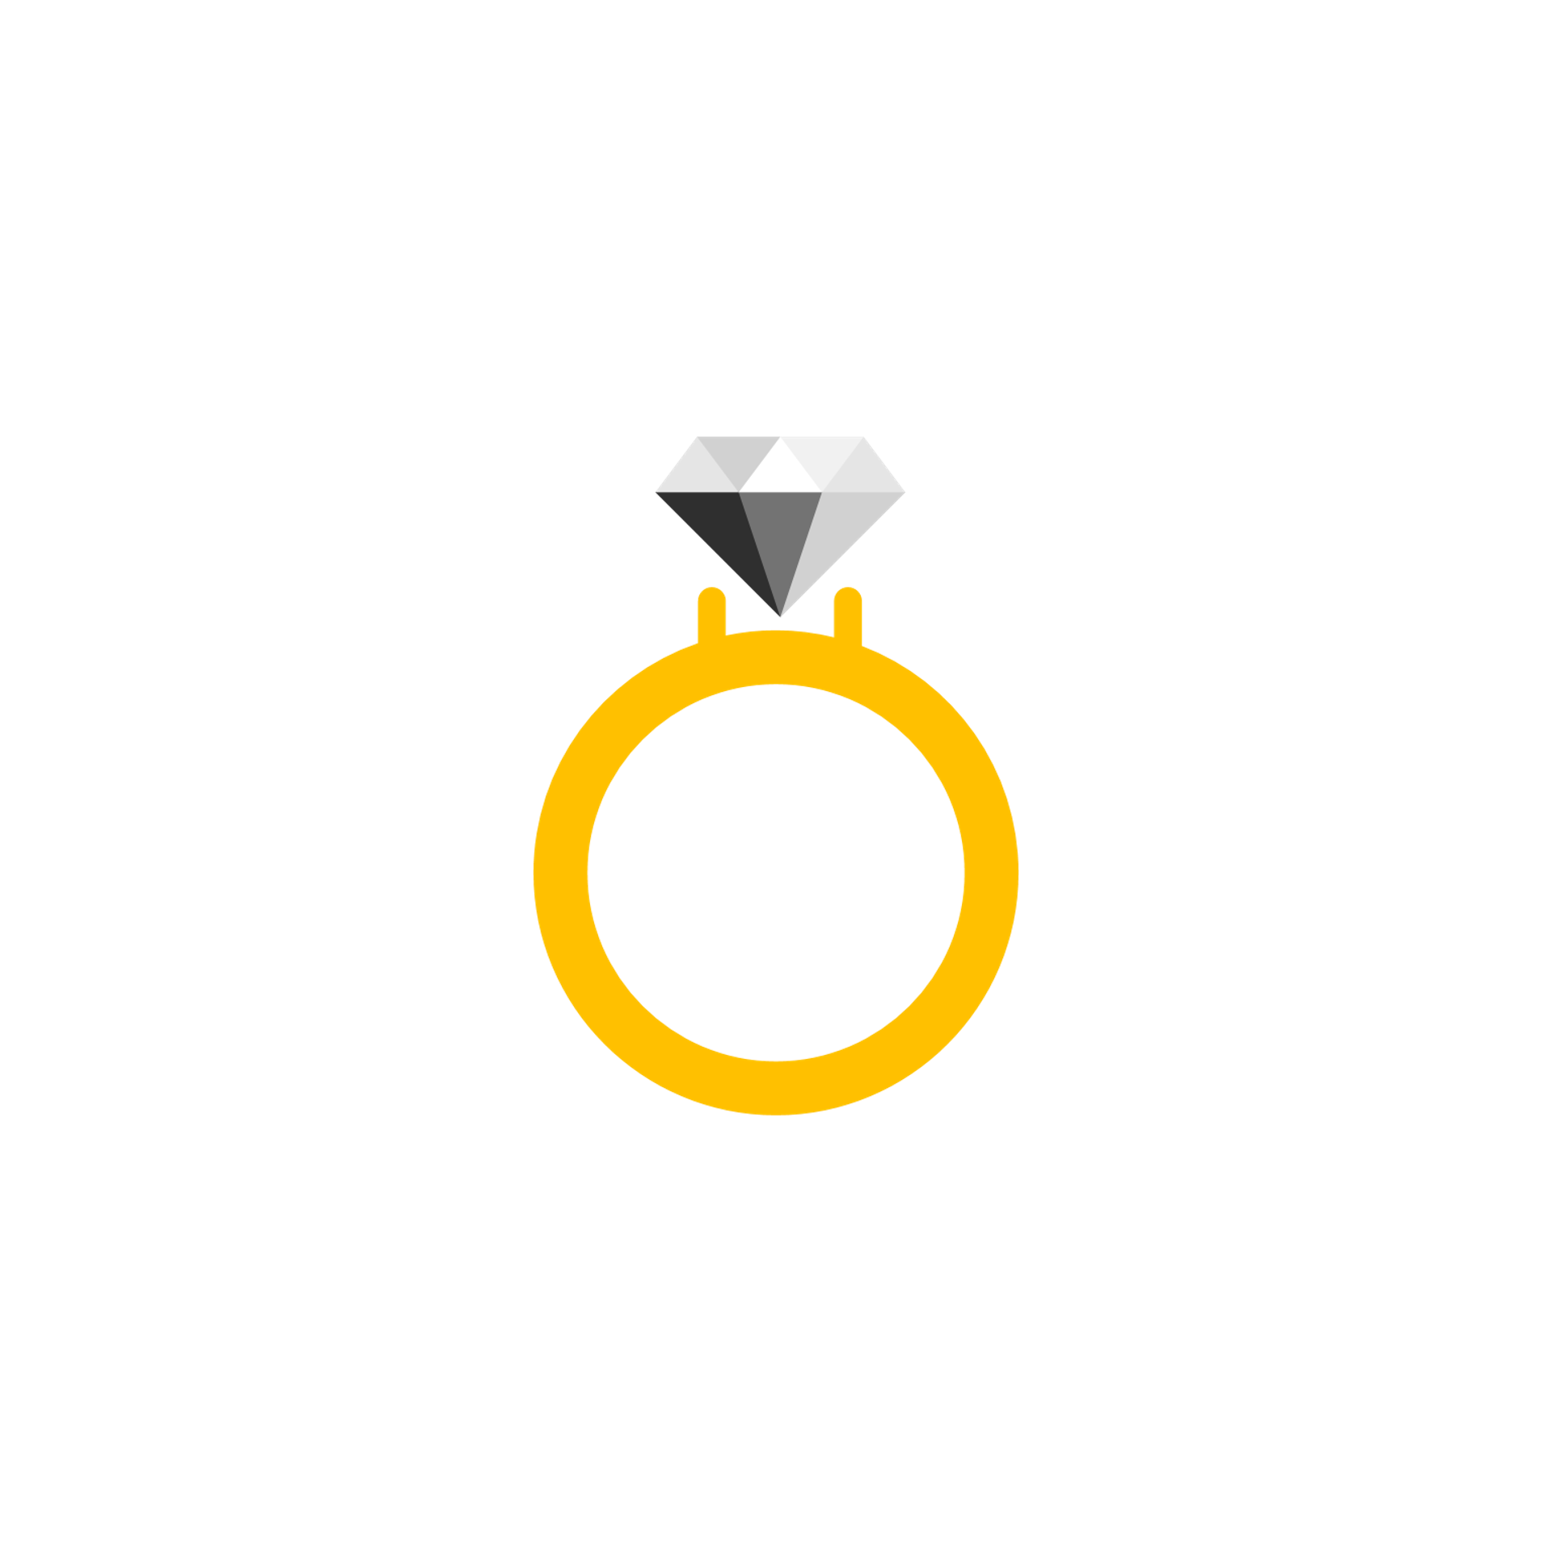

Slide 13
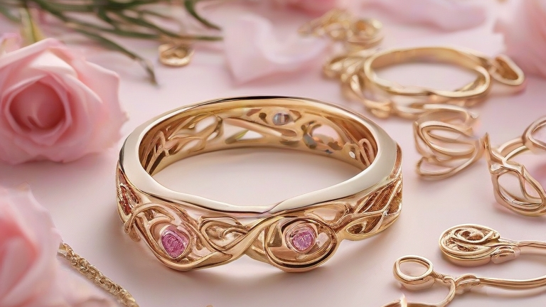
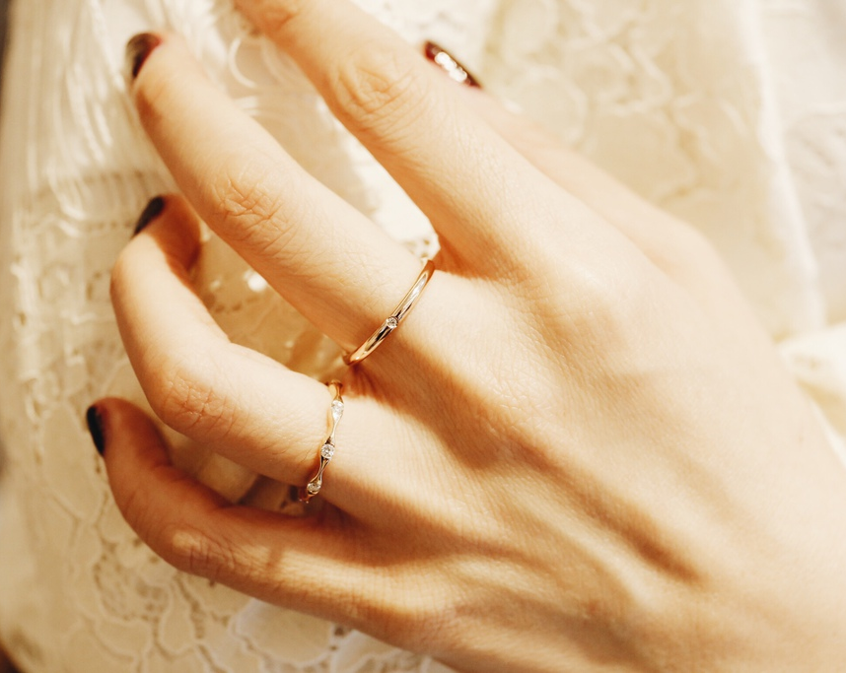
Product Introduction
Connection hopes to become the ideal ring destination for friends and couples ring needs. We hope to provide a space in which customers can shop and create unique artisan and luxurious rings. These ring will commemorate special events. Memories will be made through our professional and passionate staff interactions. Guiding consumers through the process are skilled jewelers who will assure maximum customer satisfaction and discover the joy of working with metals.
這張相片 (作者: 未知的作者) 已透過 CC BY-NC-ND 授權。

Slide 14
Product
Provide Workshop for people to create ring with passionate Instruction and Service
這張相片 (作者: 未知的作者) 已透過 CC BY-NC-ND 授權。

Slide 15
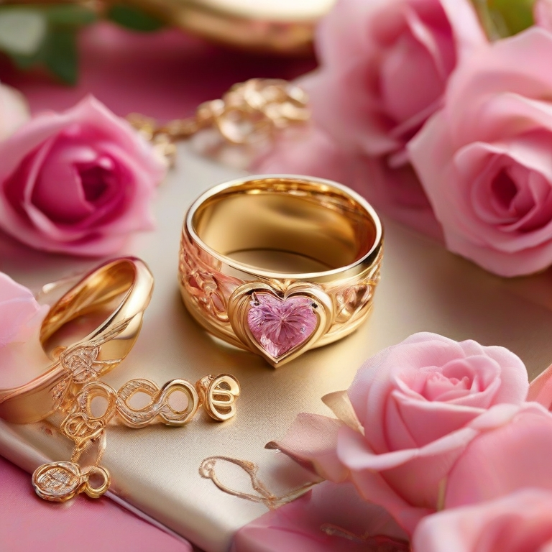
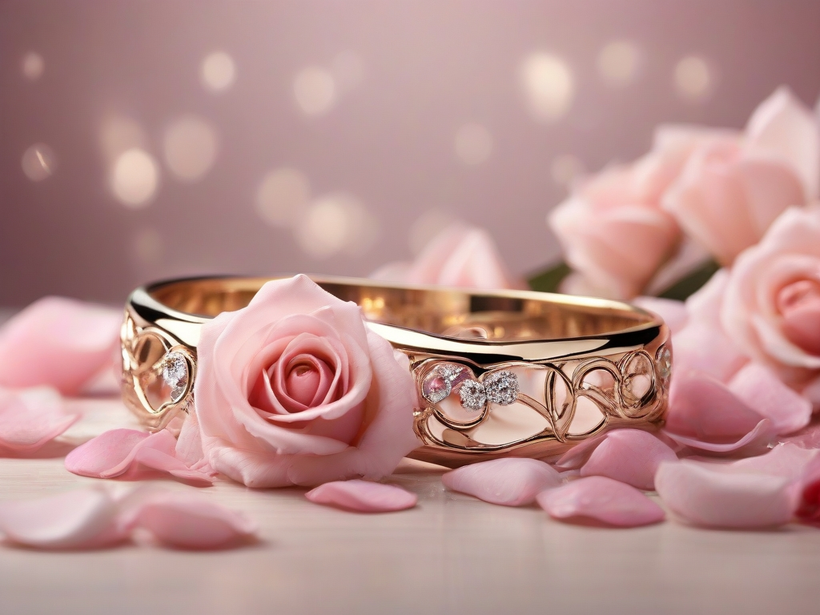
Value provide
Create precious memories with friend and loved one (We help to take photos)
Provide a space to bring an idea to life (joy and achievement)
Taking a break from the complexities of daily life

Slide 16


Data on Market Size
Jewlery Market Size is 353.26 billion dollars
Ring segment will grow 2% due to improvements in men's fashion in Asia, China, and India
Market appears to grow approximate 5% from 2023- 2030

Slide 17



DIY Ring
DIY Ring with Natural Diamonds
DIY Ring with Lab Diamonds
Only Gold
Only Platinum
Target Markets
Jewelry
Rings
Custom Ring

Slide 18

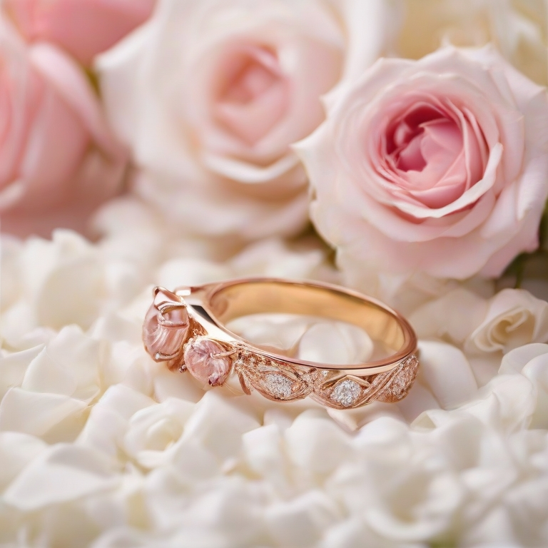
Market Problem
Lack of customizable ability
People are always looking for new experience for dating events
The coaching quality for DIY workshop is unclear
The information for DIY options is limited
Source: Interview
https://www.intimateweddings.com/blog/diy-wedding-rings-is-a-ring-workshop-for-you/
https://www.krikawa.com/studio/local-services/make-your-own-engagement-ring-and-wedding-band

Slide 19
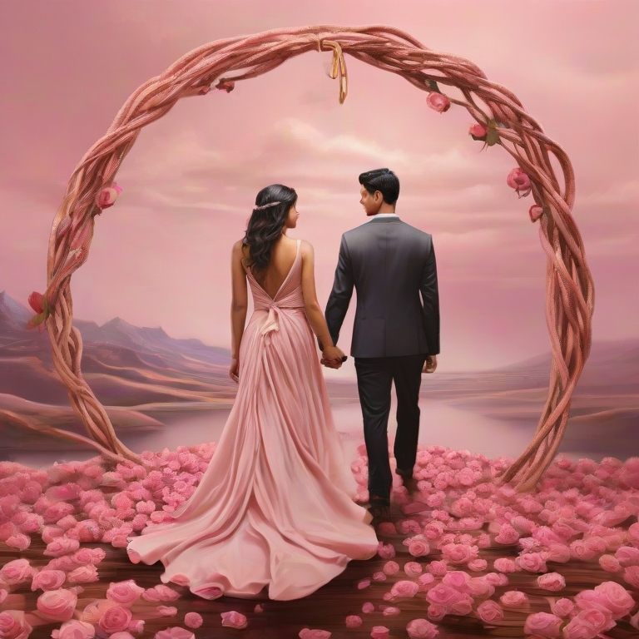
Market Problem Solve
Connection is different:
Customizable ability is high (Size, style)
A place for friends and partner to spend time and create memories
limited number of customer per mentor
Employees are enthusiasm and professional
Provide transparent and concise information before and during the workshop

Slide 20
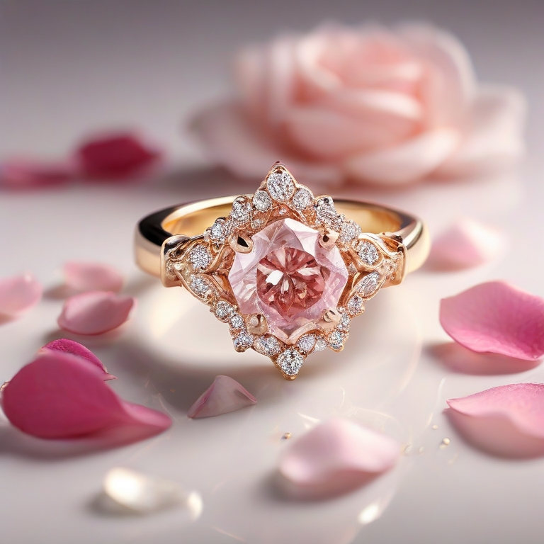
Challenges
Saturation in the Market
High barriers to penetrate
Changing Consumer's habit
Economic Downturn
Inflation
Geopolitical Issues
Conflict in Middle East causing diamond supply issue

Slide 21
Company Needs
Strong brand value
Ability to grow brand through social media trends
Lower costumer acquisition costs by optimize customer mix
Skilled and passionate craftsmen
Focused differentiation strategies with the use of technology
Good Reputation

Slide 22
SWOT
Analysis

Slide 23

Strengths
Strong demand for a range of events.
The ability to customize, unique result.
Strong customer service
Advanced technology
Engaged employees
Strong corporate culture

Slide 24

Weakness
Limited capacity for customer
Demand fluctuations according to the seasons.
Inadequate supply chain
Weak Brand Reputation
Slower to market than competitors

Slide 25

Digital marketing and e-commerce growth.
Securing specialized markets with unique experience.
Possibility of word-of-mouth promotion.
O pportunities

Slide 26
Threats
The impact of economic downturns on consumer expenditure.
Conflict with well-known jewelry companies.
Market rivalry for gifts.
Fast-paced society

Slide 27
External Market Environment

Slide 28
Competitors
Traditional jewelry and Retailer online
Over 62,722 Jewelry Stores in USA
Luxury bands
27% of Jewelry owner in USA use Tiffany & Co
Other DIY events
Over 200 DIY events round Jersey City alone
Source: https://www.statista.com/topics/5841/jewelry-market-in-the-united-states/#dossier-chapter3
https://www.ibisworld.com/industry-statistics/number-of-businesses/jewelry-stores-united-states/

Slide 29
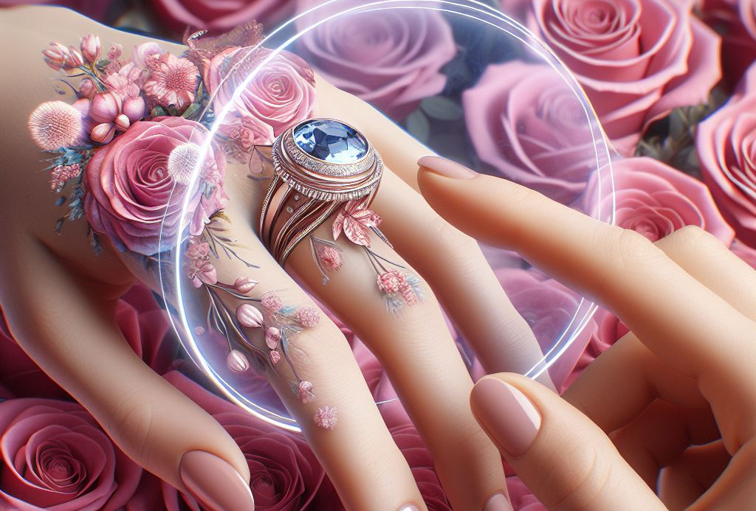
Differentiae and Positioning
Connection will be providing sophisticated technology that helps customer with The best design and Experience which will highly be different with other companies.
The Tech Source provide by the connection are user friendly with guidance
Design creation by using promote , Ex : Midjourney
AR visualization, see how ring looks on your finger

Slide 30
Data on Competiton
Tiffany
86.3 billion revenue in 2022
Up 22% year over year
Pandora
3.76 billion revenue in 2022
Up 3.2 % year of year
Swarovski
1.9 billion sales in 2022

Slide 31
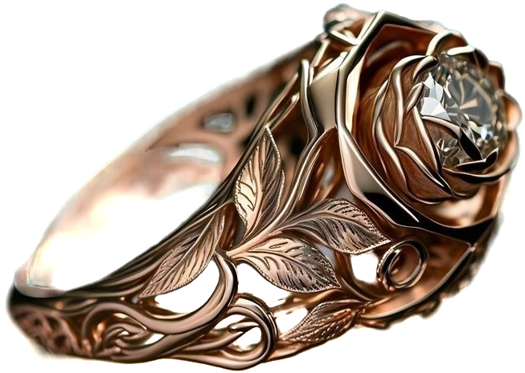
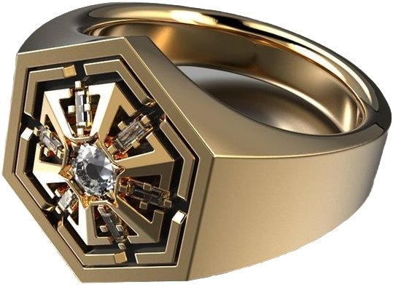
4 P's
Product:
Provide Workshop for people to create ring with passionate Instruction and Service
We provide a place for customer to create memories, offering a temporary escape from the complexities of daily life
Tech support for design
Product
Place
Price
Promotion

Slide 32
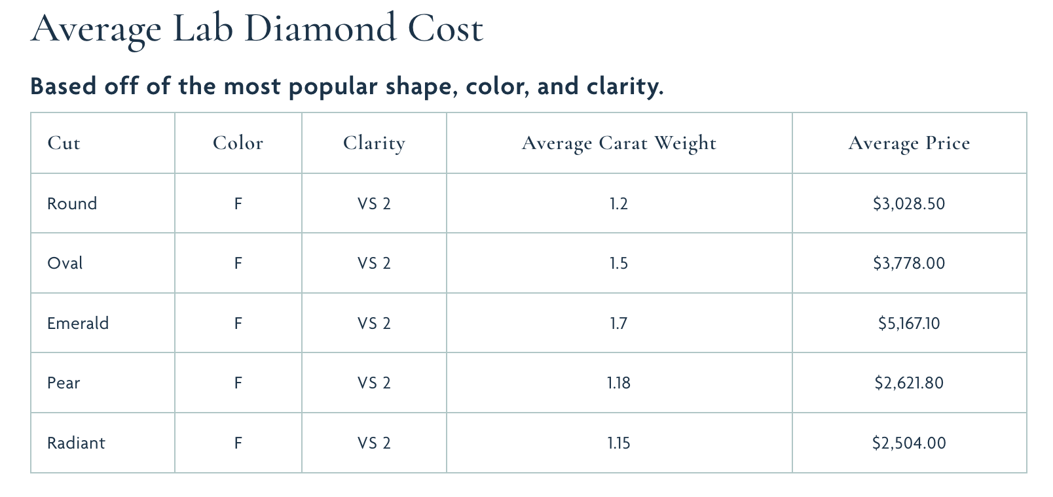
4 P's
Price:
The cost for our service come in three parts: rent, employee and material
Our customer value professional and comfortable experience so we maintain our price to provide premium service and material used
Diverse price: range from $200~$3000
Source: https://www.withclarity.com/blogs/diamond/lab-diamond-carat-and-cost

Slide 33
4 P's
Promotion:
We are in the push phase
Through mobiles ads
Duration: First half year
First time two people, second person free
First time one person, 30% off
Get awareness

Slide 34
4 P's
Place:
Locate around shopping area and residential area
Provide walk-in consulting about the service
Display prototype of the rings
Media on owned page, Facebook, and google store.

Slide 35

Best Usage of Technology
Ability to use AI in design for customers who are not creative.
Use Machine Learning to understand style of consumer through photographic inputs
Use augmented reality to see how a customize ring will appear on user

Slide 36

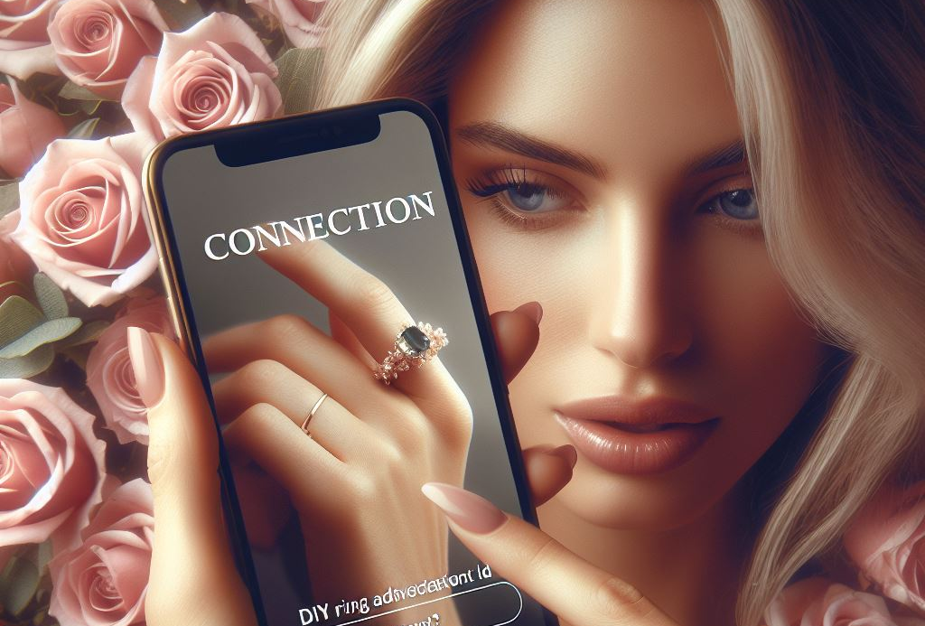
Google Adds Campaign
7 day ad trial
We listed our target costumer from customer interviews
We sent the potential customers to our Instagram page

Slide 37
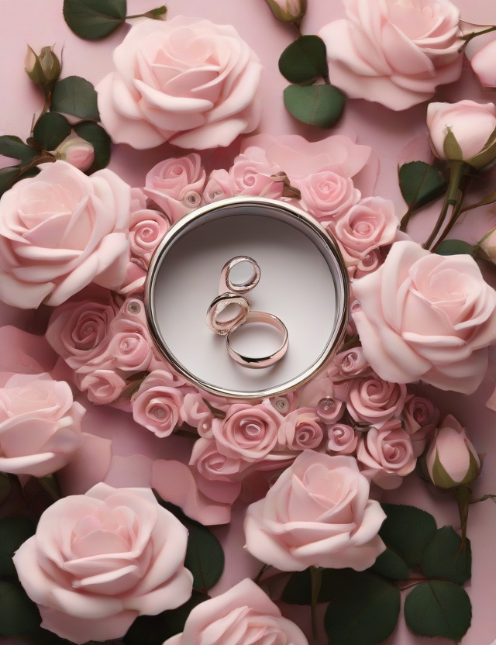
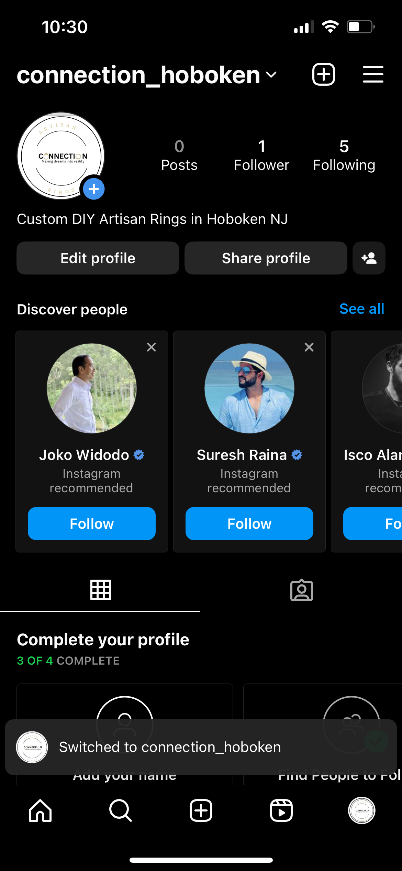
Instagram
Preliminary design
Best platform for rapid growth
Easy to share information easily
Cross platform approach with Facebook

Slide 38
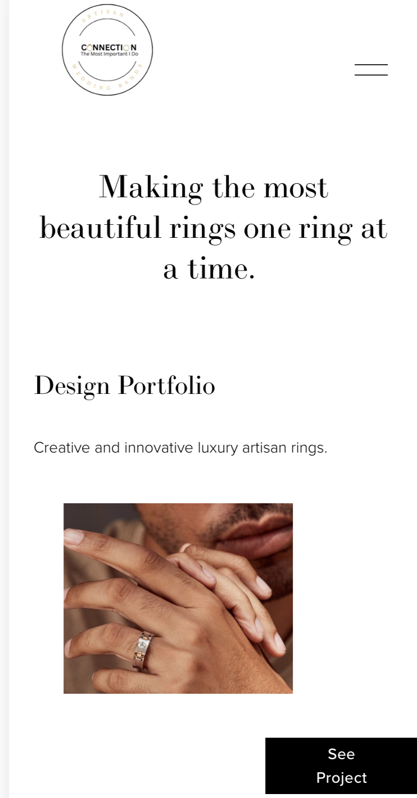
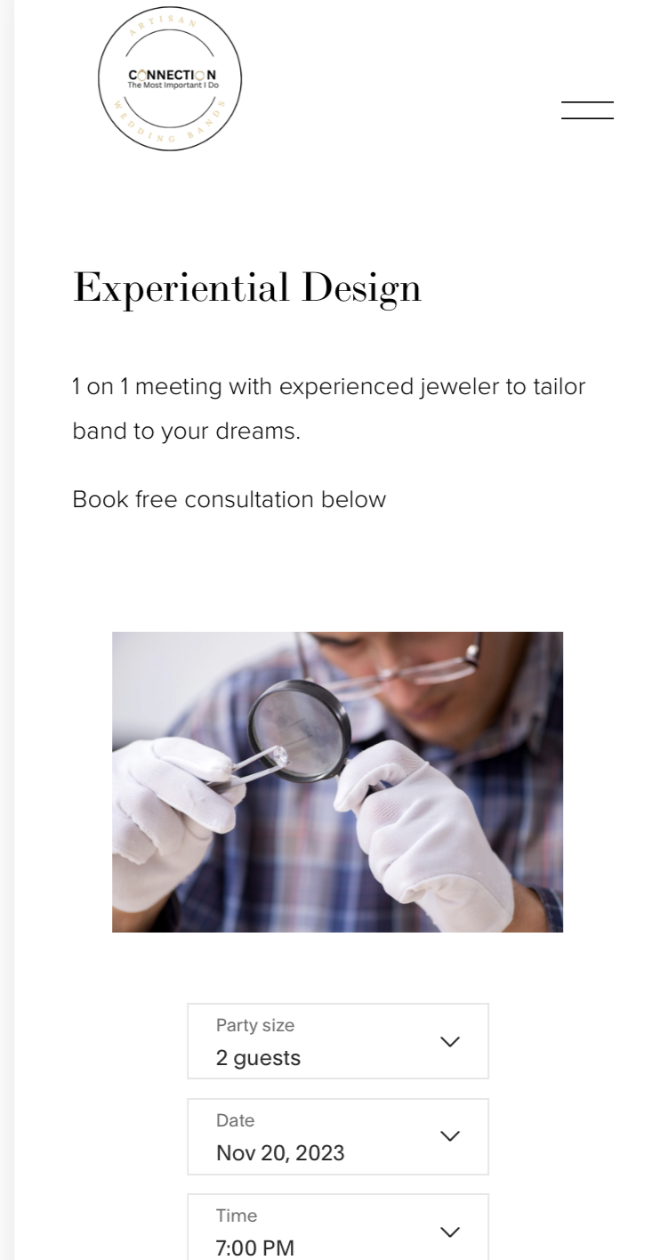
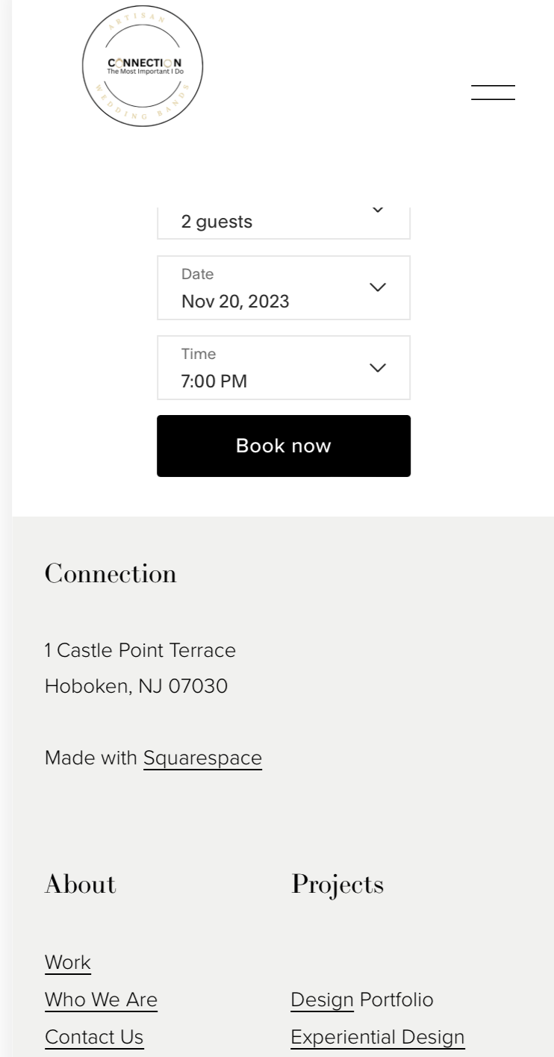
Website

Slide 39
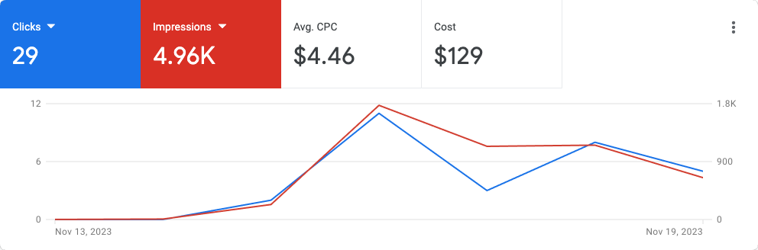
Data Collection Overview
From NOV 13 to NOV 19

Slide 40

Point Metal Art Interview:
We are acutely aware that continuous price competition, in the long run, only leads to vicious competition and poses a significant crisis for the entire industry. The key to sustainable operation lies in identifying our unique characteristics, building a strong reputation, gaining the trust and support of customers, and constantly enhancing the value of our services.

Slide 41

Kodak Jewlers Interview:
W Kodak Jewlers is a Hoboken market leader in fine jewelry with 2 locations in the Mile Square City
They expressed +3 visits for custom jewelry from start to end
Biggest issue is miscommunication currently happening between store and client causing unforeseen delays.

Slide 42


Laprong Jewlers Interview:
Laprong Jewelry is one of the best leading company in USA which is Offering to Make your own rings on your hands.
Joseph is The Owner and Director of Laprong jewelry. He offers Service and Material to Make your own designed ring as for your requirement.

Slide 43
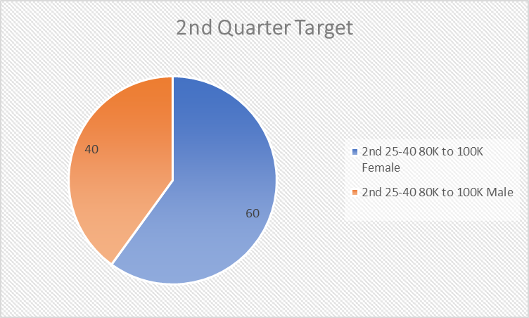
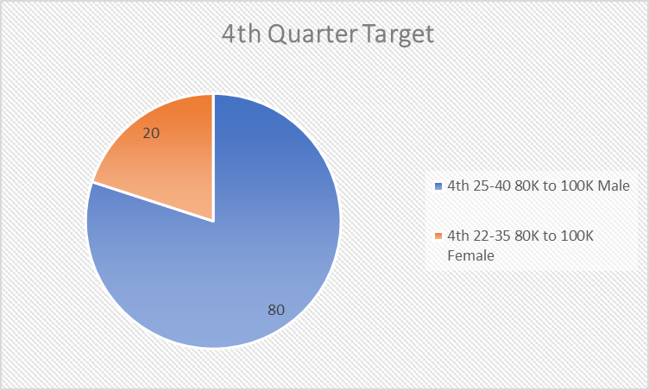
Target Market of Laprong

Slide 44
Fund Raising
Variable cost
Staff: 3 full time member $180,000 per year
Material: Silver Prices Per Ounce $25.55
Ads and other: $25000 per year
Fixed cost
Rent: $5000 per month $60,000 per year
Other: $4,000 per year
One-time charge:
Equipment: $4,000
Renovation: $30,000
Source: https://www.amazon.com/CUEA-Professional-Stainless-Machine-Accessory/dp/B08RNPKZR6
https://www.crd.cn/huangjin/35329.html
Expect revenue first year
$245,600
Expect profit first year
$35,780
Expect Fund raise: $151500
Basic cost per year: $303000
Notes:
https://nydecoration.com/%E5%BA%97%E9%9D%A2%E8%A3%85%E4%BF%AE%E8%AE%BE%E8%AE%A1%EF%BC%88%E7%B3%BB%E5%88%97%E2%91%A3%EF%BC%89%E5%BA%97%E9%9D%A2%E8%A3%85%E4%BF%AE%E8%B4%B9%E7%94%A8/

Slide 45

Thank You

